Slide 1
超越学科界限的认知基础 Transdisciplinary Cognitive Foundation Week 10 Artificial Intelligence and its Social Impacts
Ben Koo
November 16, 2020

Slide 2
Content Themes for the semester
Cybernetics (Control and Communication)
Smart City and Internet of Things
Artificial Intelligence and its Social Impacts
Arts/Skills/Human Talents in the Digital Era
Student proposed Application Topics
Rehearsal
Final Reports and Celebration
A Cognitive Foundation grounded on Encoded Symmetries
Namespace Management, Orientational Terms
Biology, Physics, Math, Code is Law, and Society
Story Telling, Functions/Metaphors/Analogies
Writing, Accounting, Historical Data and Temporal Reasoning
Knowledge Representation in Wiki and Files
Recursion and Continuation (DevOps/CICD)
Midterm Reports by Students

Slide 3

The Master Algorithm that will rule the world?
Bill Gates recommended this book
in 2016 Code Conference
The thesis:
Processing data through a single universal learning algorithm— can get all the knowledge from the past, the present, and the future
Pedro Domingos, TMA, P. 25
Chinese Translation
3

Slide 4
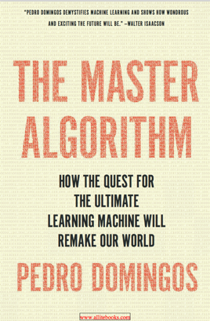
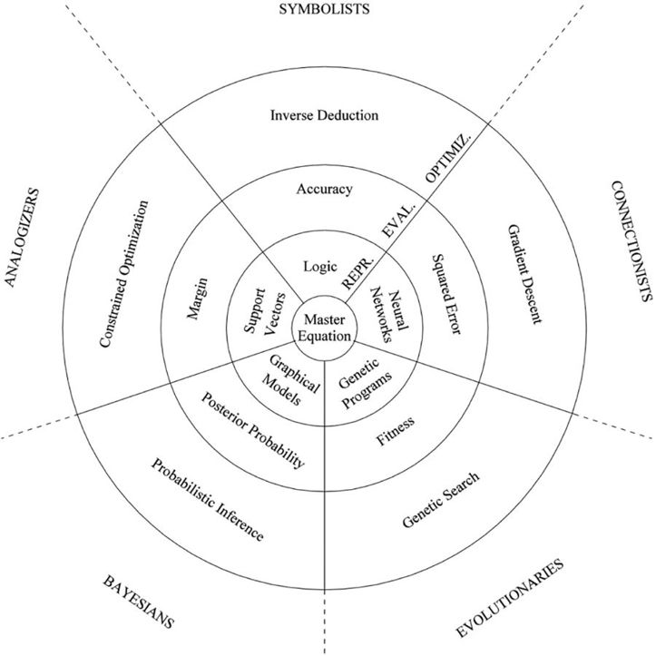
The Master Algorithm with Five Elements
（寓言）
Chinese Translation
Image Source: P. 240 of The Master Algorithm
4

Slide 5

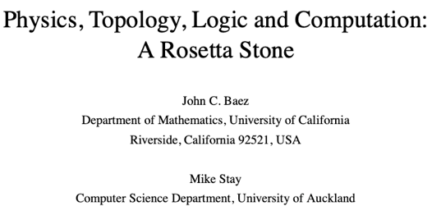
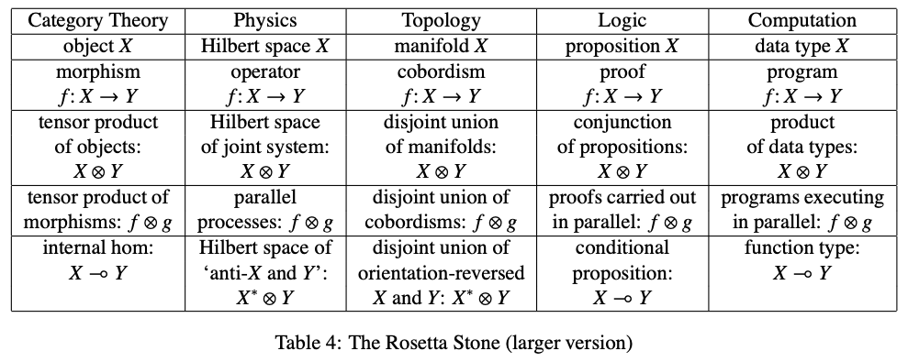
The Rosetta Stone by John Baez
Image source: wikipedia

Slide 6
The Master Algorithm with Five Elements
（寓言）
The Allegory of a Smart City made of 3 concentric circles and occupied by 5 tribes:
Circles:
Optimization (Search)
Evaluation (Rewrite)
Representation (NsM)
Master
Equation
Chinese Translation
Tribes:
Symbolists
Connectionists
Evolutionaries
Bayesians
Analogizers
Image Source: P. 240 of The Master Algorithm
6

Slide 7
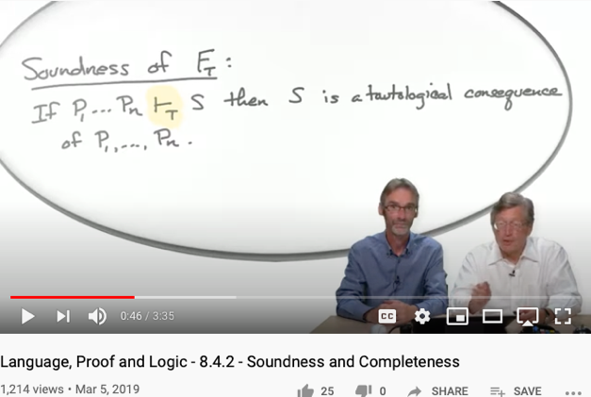
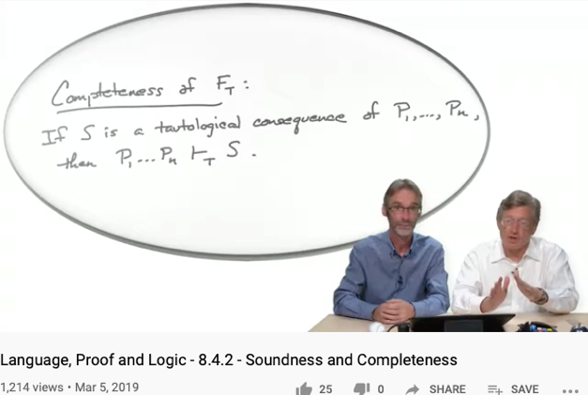
Soundness
Completeness
Every provable statement is true
Every true statement is provable
Cited from : Soundness and Completeness: With Precision on news.ycombinator.com
https://youtu.be/3hspKYIn5ds?t=29
https://youtu.be/3hspKYIn5ds?t=162

Slide 8

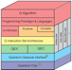













An integrated (ethical) architecture
to implement the Master Algorithm
Software
Hardware
Scientific “Evolution”
Neutral Network
Symbolic Logic
Causal Probability
Conceptual Analogies
T. Kuhn
Content
IoT and Quantum Computing
TPU
GPU
CPU
Big Data
Computed Data
Artificial Data
Resource
Standard
J. Hinton
Distributed
Centralized
General Protocol
S. Wolfram
J. Pearl
Governance Strategies
Collective learning systems
Data Assets, Structures
Extreme Learning Process
G. Lakoff
Computing Architectures, Instrumentation
Encoding strategy, Ontology, Epistemology

Slide 9
The Expanded Capability of “Search”
and how AI relates to them
Capability | AI inspired threats | Solution to AI threats
Search | Digesting overwhelming amount of knowledge | Apply search to private knowledge
Optimize | Solve problems assumed to be impossible | Become aware when impossible become possible
Simulate | Offer future plans at rates much higher than traditional wisdom | Update inadequate possibility model of our surroundings

Slide 10


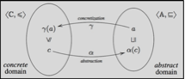
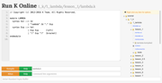

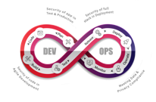
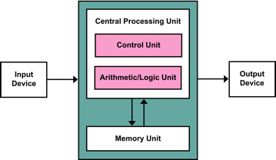
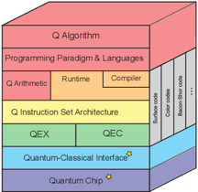






Computing Architectures associated with Tools
Abstract Specification
Cloud Computing
Deterministic
Probabilistic
Centralized
Hybrid
Distributed
Single/Multi Core
Many Core
Single Site
Multi Site
Many Site
Hackerspaces
Super Computing Center
Notes:
10

Slide 11

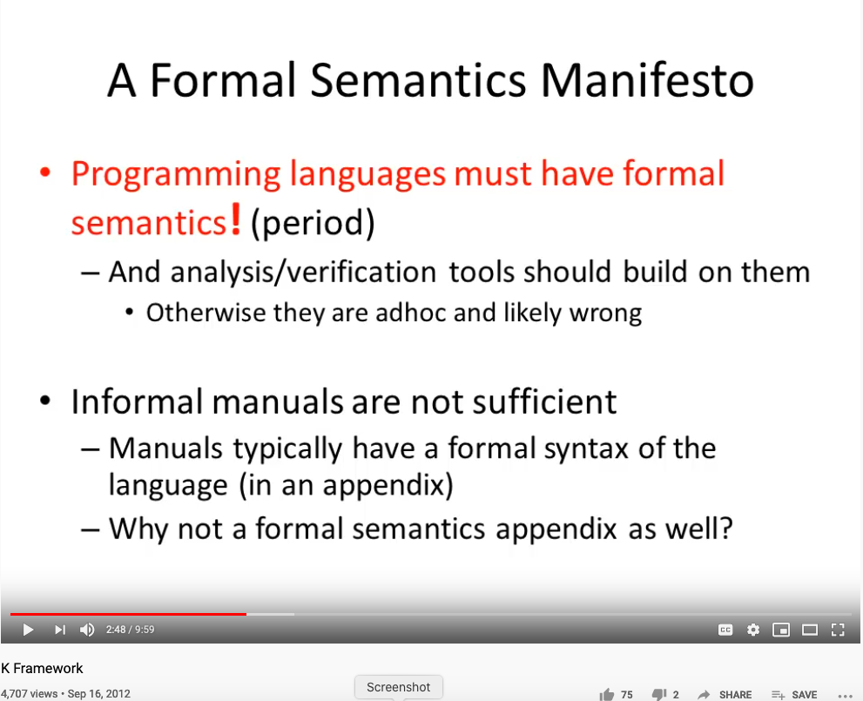
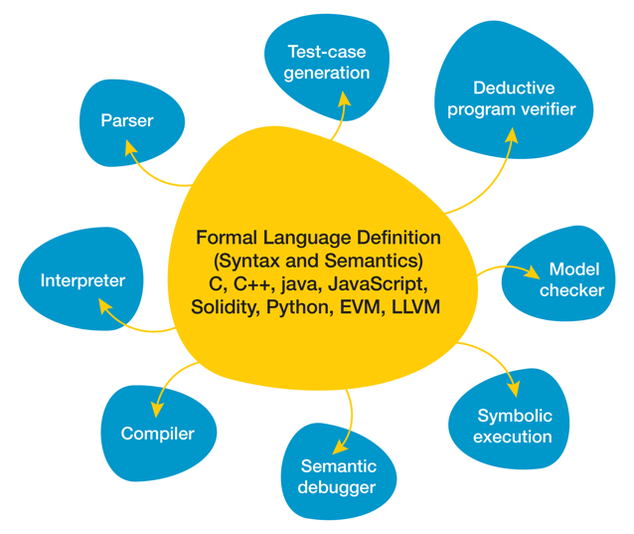
How to Reason about Namespace Rigorously?
Huawei VP Mr. Yang Shaoqing
The K Framework & Formal Verification Efforts in the Blockchain Space
By Ola Kohut
RICH 70 Tsinghua SEA Cloud Forum, Sep 14, 2020
H. E. Bambang Brodjonegoro,
Minister of Research & Technology, Indonesia

Slide 12
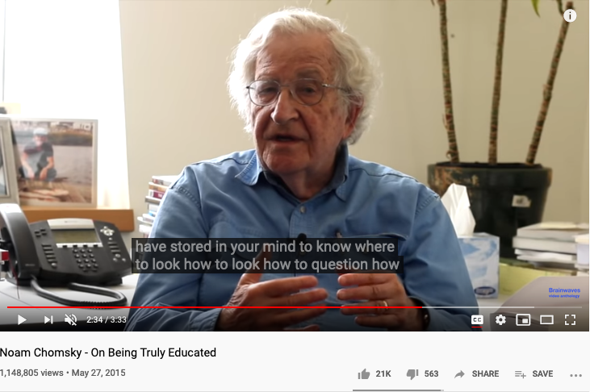
On Being Truly Educated
Prof. Noam Chomsky: the founder of modern cognitive sciences.

Slide 13
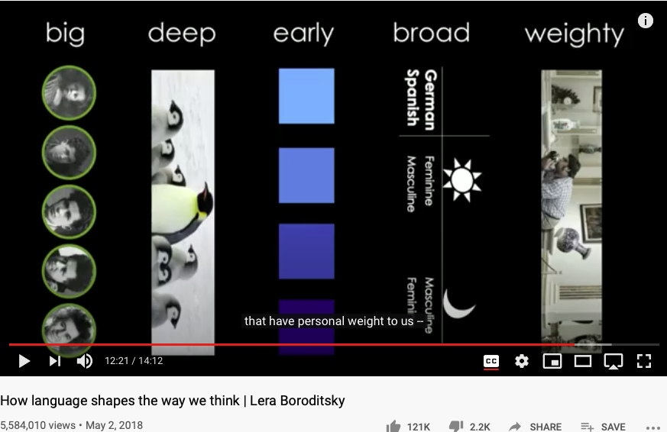
Language choices influence your Cognitive Foundation
Huawei VP Mr. Yang Shaoqing
https://youtu.be/RKK7wGAYP6k

Slide 14
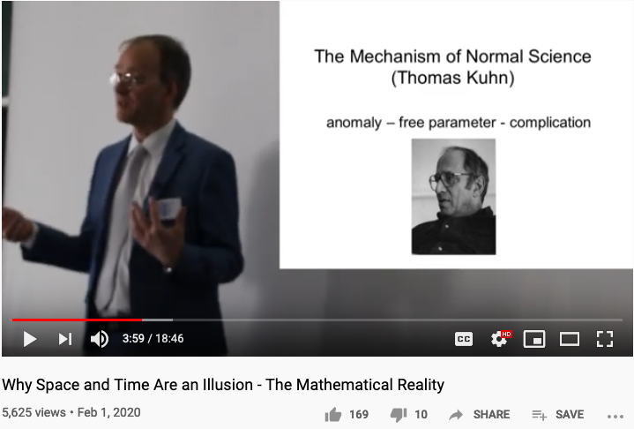
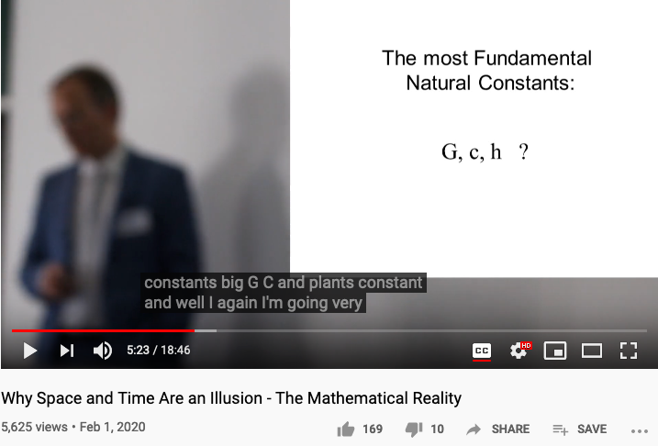
Reserved Names and Constants in Sciences
Unzicker’s Observations:
Revolutions in physics have always eliminated arbitrary numbers
A complete theory of reality must do without any constants of nature
https://youtu.be/zxAV_Re4OWA?t=239
https://youtu.be/zxAV_Re4OWA?t=323
On the origin of constants C and h, by Alexander Unzicker, last accessed Oct 20, 2020

Slide 15
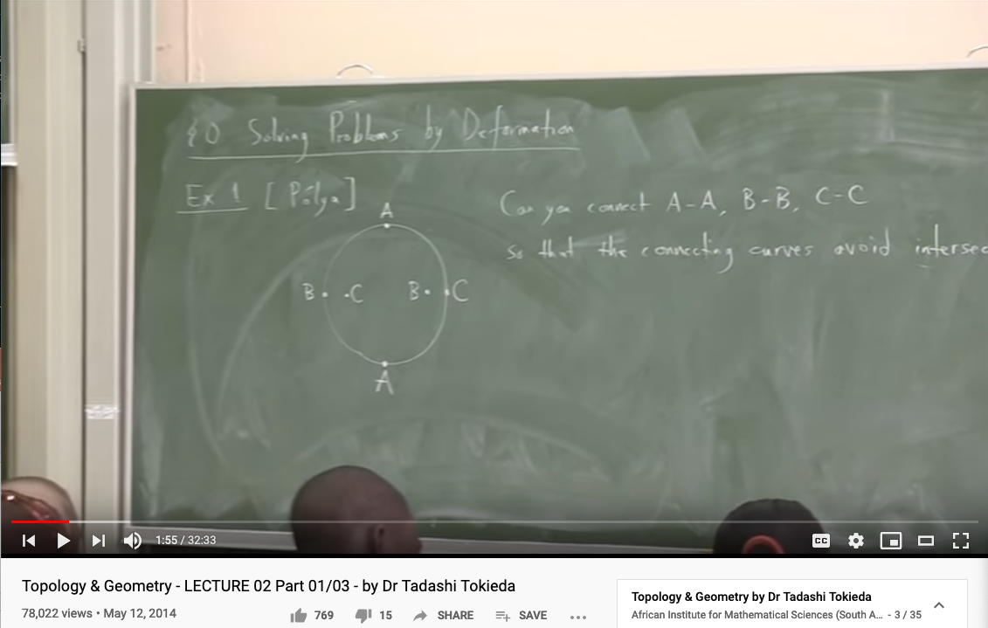
Knowledge Representation in Topology (the trick of converting a problem to a simple domain and back)
Youtube Link: https://youtu.be/8YDw4YxT-FM?t=398

Slide 16
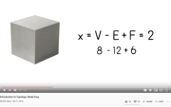
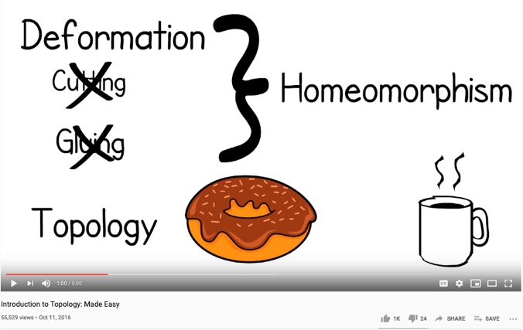
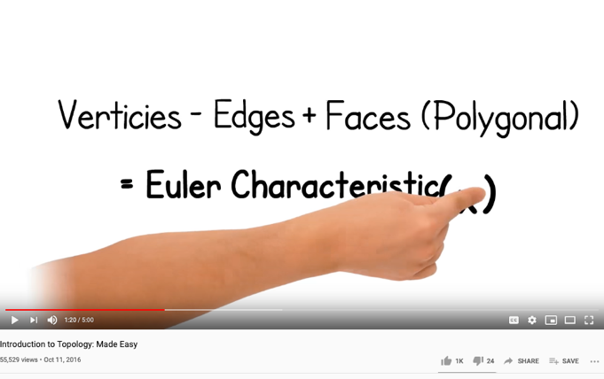
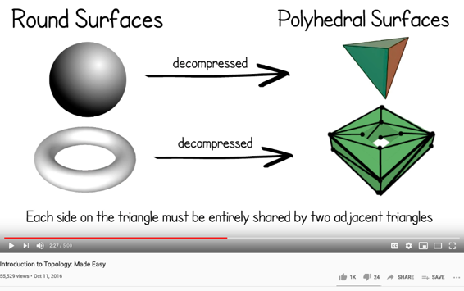
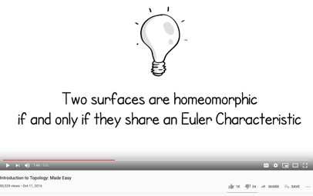
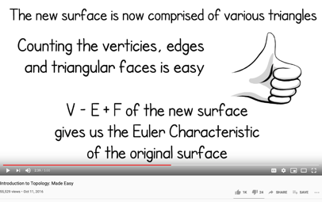
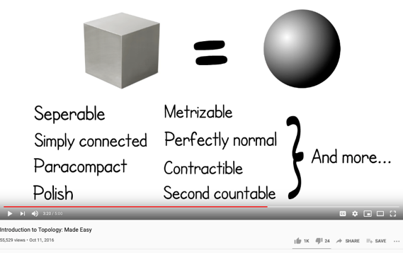
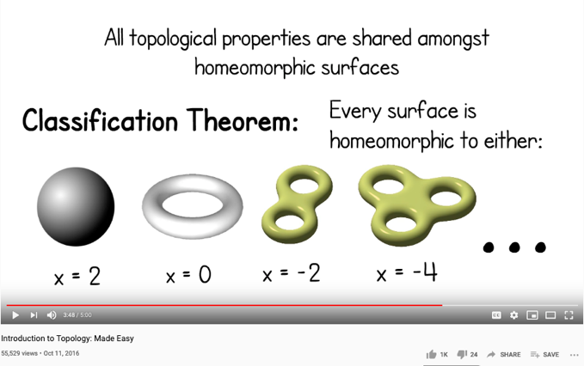
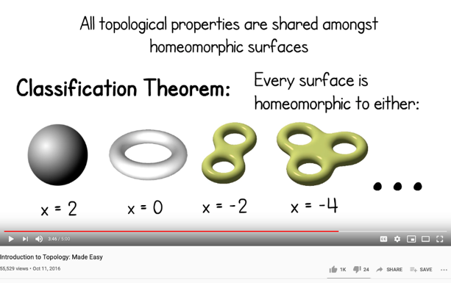
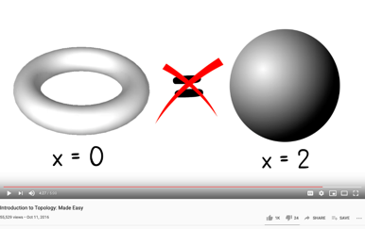
Homeomorphisms as a way to establish Equivalence
Image and Text Source: https://youtu.be/VOKgMJEc_ro

Slide 17
Computationally-Enhanced Cognitive Foundation Transcending the Boundaries of Human, Machines, and Knowledge Disciplines
Huawei VP Mr. Yang Shaoqing

Slide 18
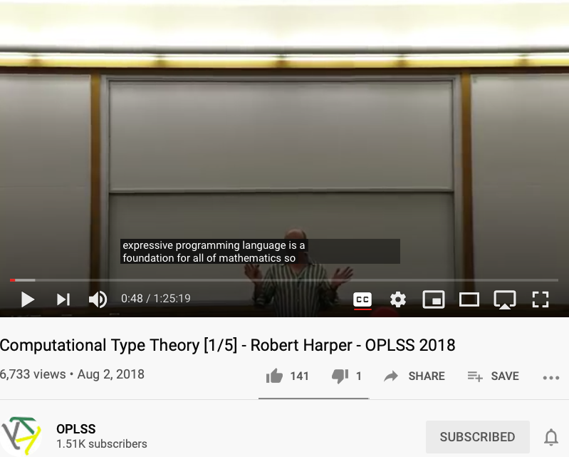
The foundation of math as programming languages
Prof. Robert Harper

Slide 19
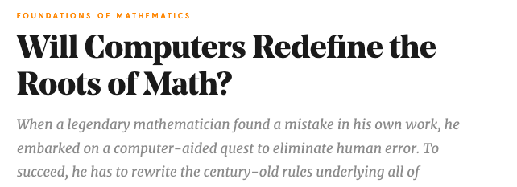
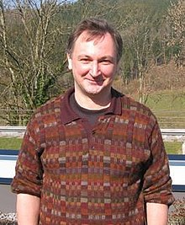

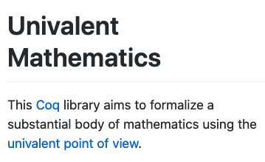

The man who redefined Equal in Math!
By Kevin Hartnett
Vladimir Voevodsky

Slide 20
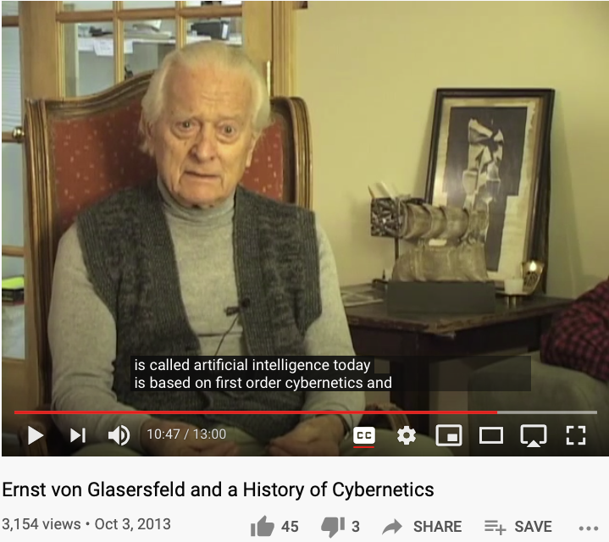
First and Second Order Cybernetics

Slide 21
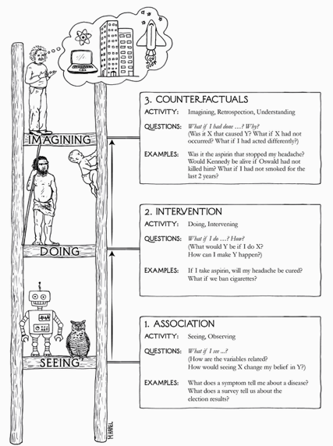


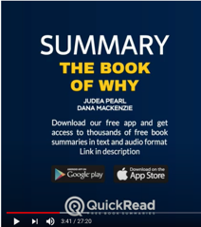
The Book of Why

Slide 22
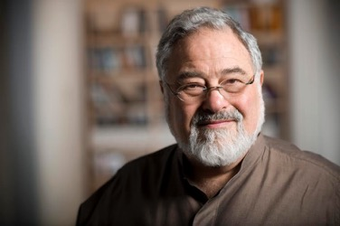
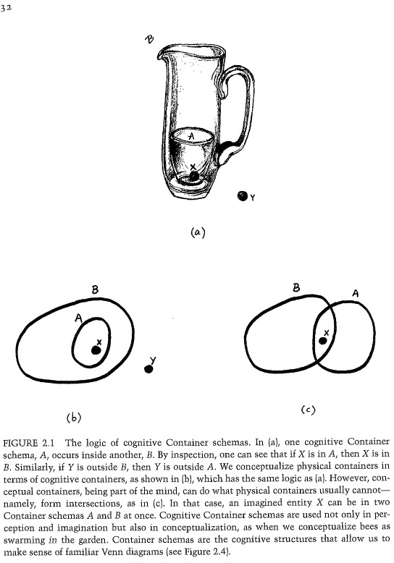
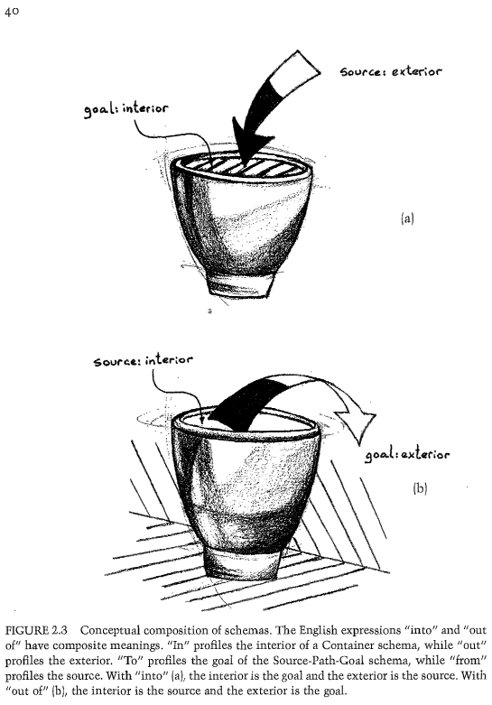

The expressive power of Names (labels)
Huawei VP Mr. Yang Shaoqing
Prof. George Lakoff

Slide 23
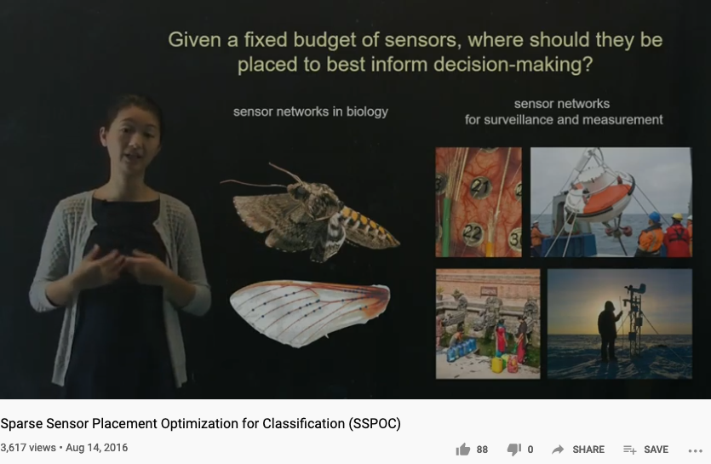
Sensor Placement and Data Collection

Slide 24
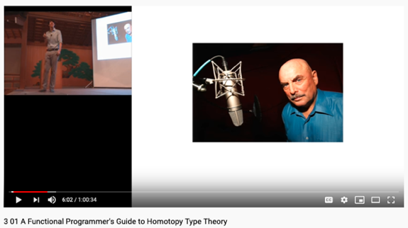
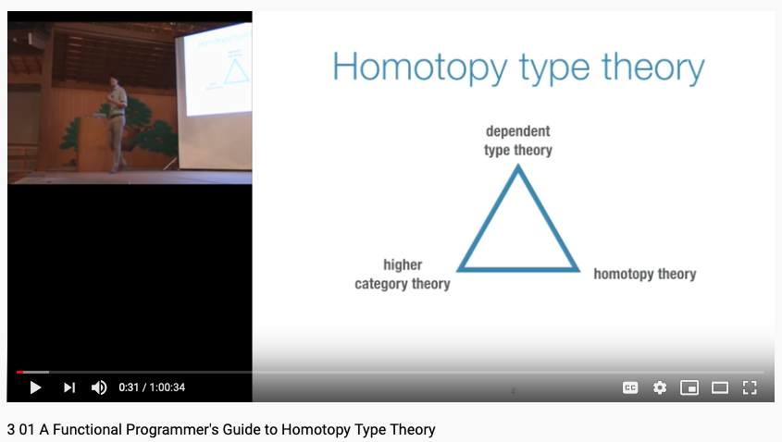
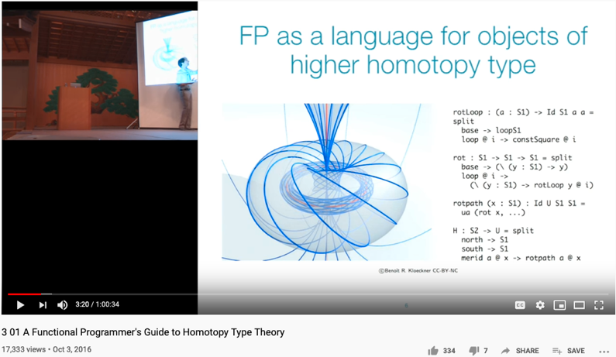
Main Thesis of this course: “How do you know that you know?”
Don Lafontaine
A transdisciplinary foundation in math and programming by Prof. Dan Licata, Wesleyan University

Slide 25
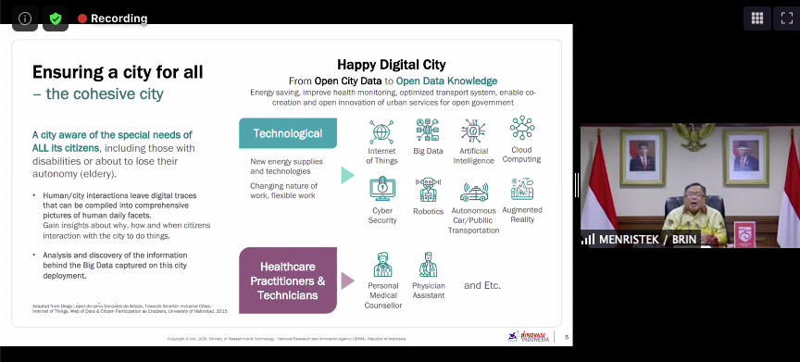

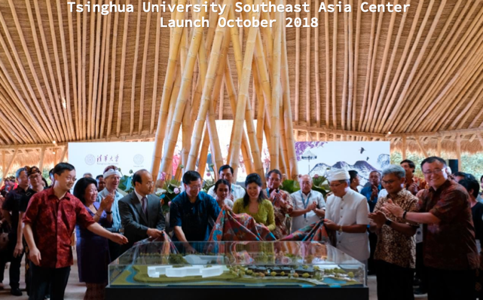
On-Going Events related to the course
Huawei VP Mr. Yang Shaoqing
RICH 70 Tsinghua SEA Cloud Forum, Sep 14, 2020
H. E. Bambang Brodjonegoro,
Minister of Research & Technology, Indonesia
RICH 70 Tsinghua SEA Cloud Forum, Sep 14, 2020
H. E. Bambang Brodjonegoro,
Minister of Research & Technology, Indonesia

Slide 26
AUDIENCE
Registered Students@THU
A course FOR ALL Disciplines
Fulfills Liberal Arts Req. (通识课)

Slide 27
AUDIENCE (self-intro)
Everyone speak for 120 seconds
Your name
Department Association
Why do you choose this class?
What do you expect to learn?
What is your strongest trait?
Any knowledge related to cognitive science?

Slide 28
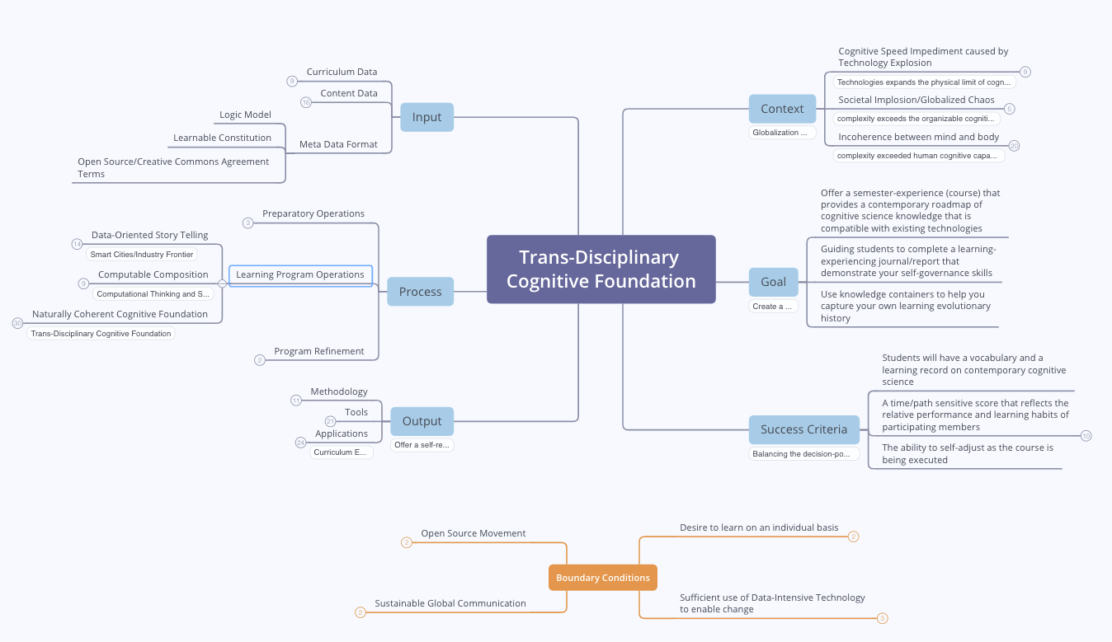
Course Outline

Slide 29
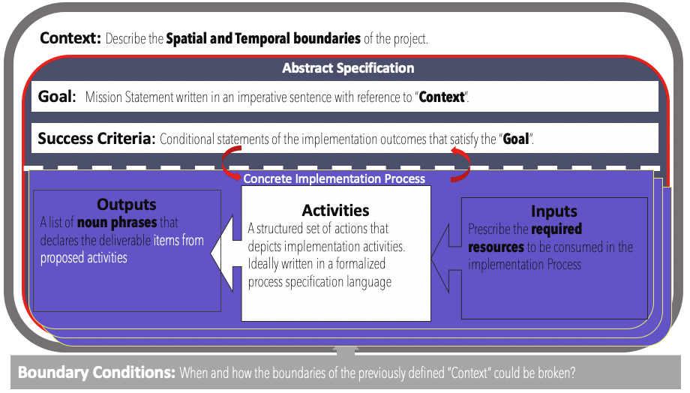
Logic Model (OKRs) as a Transdisciplinary Foundation

Slide 30


Objective & Key Results (OKRs)
Objectives
A statement of a broad goal,
Usually qualitative in nature.
Key Results
A statement that measures
Achievement of a given objective

Slide 31



Reference Materials on OKRs

Slide 32
Context: Describe the Spatial and Temporal boundaries of the project.
Contextualized Objectives
Goal: Mission Statement written in an imperative sentence with reference to “Context”.
Success Criteria: Conditional statements of the implementation outcomes that satisfy the “Goal”.
Concrete Implementation Process
Process that Delivers Key Results
Outputs
A list of noun phrases that declares the deliverable items from proposed activities
Activities
A structured set of actions that depicts implementation activities.
Ideally written in a formalized process specification language
Outputs
A list of noun phrases that declares the deliverable items from proposed activities
Activities
A structured set of actions that depicts implementation activities.
Ideally written in a formalized process specification language
Inputs
Prescribe the required resources to be consumed in the implementation Process
Inputs
Prescribe the required resources to be consumed in the implementation Process
Boundary Conditions: When and how the boundaries of the previously defined ”Context” could be broken?

Slide 33


Context: Modern Technologies challenges the cognitive capacities of human and human societies.
Goal: Provide a methodical cognitive framework to leverage contemporary technologies and cognitive science content.
Success Criteria: Enable students to utilize cognitive methods and tools, while measuring learning outcomes accordingly.
Outputs
Cognitive Science Report
Summarize your methods
Digitally published Learning Reports
Behavioral Data (on MediaWiki)
Personally chosen application areas
Biology, Physics, Math, Literature, Social Science, Arts, …
Activated Processes
1. Course Preparation
Content and Process design
2. Learning Program Execution
16 week exercise
3. Program Refinement
Continuous Adjustments
Periodic Refinements
Inputs
Curricular Structure
Coherent with university-level curriculum design
Content Data
A time-oriented knowledge(data) representation framework
Meta Data Formats
Logic Model(OKRS), Learning Report Format, Universal Resource Locators
Boundary Conditions: Personal willingness to adopt a new cognitive foundation, and intensity of practicing this new skill

Slide 34
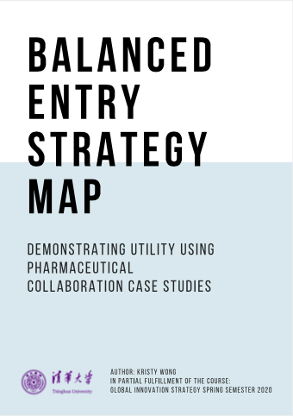
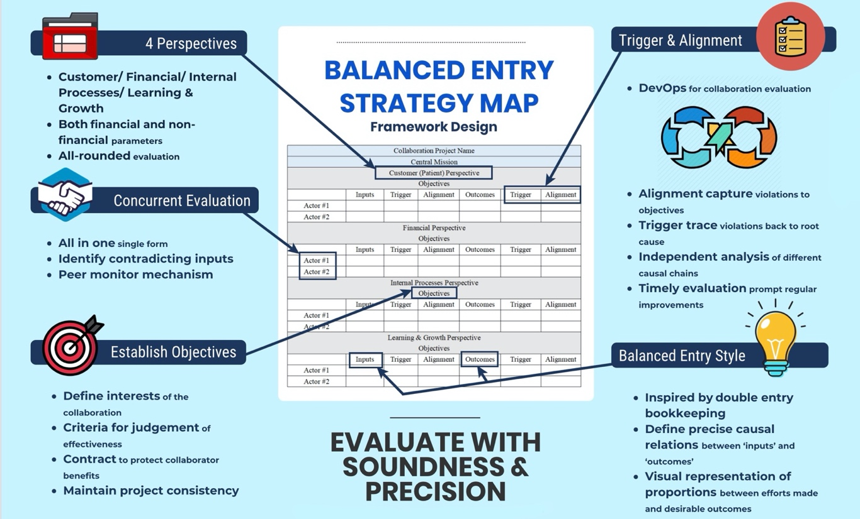
Introduce Balanced Strategy Map (BSM) by Kristy Wong A new kind of Logic Model & a variant of OKRs (Spring 2020)

Slide 35


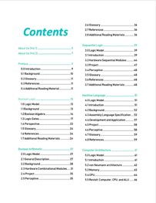


A course that invite you to investigate THINKING at multiple scales create and publish your own ideas in a digital publishing workflow…

Slide 36



2018 International Summer Program @ Tsinghua Experience a publishing workflow using DevOps

Slide 37

Context
A focused boundary in Spacetime
A statement that outlines the perimeter of project concern
Focus on contemporary situations that are most critical in directing and justifying certain goals
Remind yourself about the relevancy of potential actions
For a semester long course, plan for actions that can be finished in a few months.
Identify a desired scope of your cognitive actions ...
Image source:
Ask Ethan: Is Spacetime Really A Fabric?

Slide 38

CONTEXT that Narrows your scope of Objectives
GLOBALIZATION AND INDUSTRIALIZATION CHALLENGED THE BOUNDARY OF HUMAN COGNITIVE POWERS
THE SPEED OF CHANGES EXCEEDS MENTAL CAPACITY
Societal Implosion & Globalized Chaos
Incoherent minds and body
overwhelmed by new knowledge
lost of self-worth

Slide 39



Societal Clockspeed determines how People Think

Slide 40




Speed is the Dominant factor in Decision Making
A NEW Cognitive Foundation is needed to enable
Sufficiently FAST
collective learning!

Slide 41

Power of a Dominant Design/Protocol
“Theoretical framework: dominant category and dominant design during the industry life cycle. During the industry life cycle, the number of categories will increase before the number of firms increases. The emergence of the dominant category occurs as the number of categories begins to decrease. This point in time marks the opening of the window of opportunity for entry, whereas the emergence of the dominant design marks the closing of the window of opportunity”
Excerpt from the article:
Perfect timing? Dominant category, dominant design, and the window of opportunity for firm entry

Slide 42





The World has changed … Ways to conduct business have changed …
https://en.wikipedia.org/wiki/George_Hotz

Slide 43


Kuhn Cycle: as the ticking clock
Normal Science
Model
Drift
Model Crisis
Model Revolution
Paradigm
Change
Emerging cases or
systematic attacks
Product Development Process
in five stages
Commit
Build
Test
Stage
Deploy

Slide 44


Three Scales of Time
Mesoscopic：
Localized Adjustments
Time Stamp
Macroscopic:
Five Stages of Evolution
Normal Science
(commit)
Model
Drift
(build)
Model Crisis
(test)
Model Revolution
(stage)
Paradigm Change
(deploy)
Microscopic：
Process Data and Summative Result
Time Stamp

Slide 45
Time Stamped Data Preserve Event Ordering Information
Normal Science
(commit)
Model
Drift
(build)
Model Crisis
(test)
Model Revolution
(stage)
Paradigm Change
(deploy)
Time Stamp
Time Stamp
Time Stamp
Time Stamp

Slide 46

Blockchain, Distributed Ledger Technologies: Time is Money
https://www.investopedia.com/terms/b/blockchain.asp

Slide 47






A Model of Collective Cognitive Processes
(students/teachers)
(Smart) Social Contract Execution
Traders
Miners
Coders
(Consumers/Distributors)
Three Asynchronous
Clocks in their respective
Communities
Version Upgrade
Production Code
Function Requests
Customer Crisis
Feature Revolution
Emerging cases or
systematic attacks
(Artists/Creative Projects)
(Administrators/Witnesses)
Perform Checking
receive confirmation
commit transaction
(Content Producers/Product Designers)
(Accountants/Lawyers)

Slide 48

Smart Contract with Observable Historical Data
ISDA: International Swaps and Derivatives Association

Slide 49



Legal Algorithms: Code is Law

Slide 50
Learning Process as a Publishing Workflow
Traders
（students/teachers）
Miners
（Administrators/Witnesses）
Coders
(Artists/Creative People)
(Consumers/Distributors)
(Content Producers/Product Designers)
(Accountants/Lawyers)

Slide 51

Learnability of a Multi-Scale DevOps Process
Traders
（students/teachers）
Miners
（Administrators/Witnesses）
Coders
(Artists/Creative People)
Sec
(Consumers/Distributors)
Dev
Ops
(Content Producers/Product Designers)
(Accountants/
Notary Servicer Provider)

Slide 52

Goal
Stating objectives in scope
Use imperative sentence to express intent. Be active!
Draw on forces that are present in the context, align your argument with contextualized information
Preparing a proposition that has concrete and verifiable outcomes
For example: Colonizing human in space…
Identify a desired scope of your cognitive actions ...
Image sources:
Ask Ethan: Is Spacetime Really A Fabric?

Slide 53



GOAL
Introduce students to a domain-independent cognitive science results according to the time-based linguistic framework.
Use of the Natural Units as the core linguistic elements
A Social Contract(OKRS) for Learner’s self governance
Create a knowledge container for everyone
Capture knowledge using a Mediawiki Database
Compile personal knowledge into a publication

Slide 54

Success Criteria
A set of conditional statements that qualifies the success criteria to achieve the stated goal(s)
Conditional statements that can be judged to yes/no results
Certain success criteria can be measured in terms of degree of success (portions accomplished)
Success measures maybe assessed in terms of Time and Entropy (probability of success) values.

Slide 55
Success Criteria
Elevate Students’ Knowledge Orchestration Strategies up to the level of necessity presented by contemporary industrial complex
A foundational learning strategy that will continue to work as technologies progresses and complexity/entropy increases
Knowing the essence of data management under a dynamic context
Knowing how namespace management strategies and tools can be used to manage any projects (version control)

Slide 56
What would your gain by taking this Course?

Slide 57

Output
Deliverables at the end of Project
A list of deliverables that are encoded in a generally acceptable namespace
Define outputs in precise technical terms, using a scalable namespace management tool, such as MediaWiki
Output content should be marked with time and contributors’ non-repudiable signatures
Image Source: A Blockchain-Based Notarization Service for Biomedical Knowledge Retrieval
https://www.sciencedirect.com/science/article/pii/S2001037018300400

Slide 58



A Strategy to Stretch Cognitive Model
Enabled by modern Data Infrastructures, modern curriculum may
Be constructed by new Methods, Tools and Applications
Cognitive Model Extension

Slide 59


Driven by Linguistic/Cognitive Science
The Methods, Tools and Applications are based on
Linguistic/Cogntive and Computing Sciences
Cognitive Model Extension
“Mathematics is the art of given the same name to different things.”
― Henry Poincare

Slide 60

Representing Knowledge as Domain-Specific Languages (DSL)
Utilizing Computing Science to define
Vocabulary,
Syntactical Rules
Pragmatic Use Cases of the DSLs
Data Content is categorized in terms of
Process(Learner Behavior) Data,
Publishable Data (managed by participants)
Meta Data (formats or content index)

Slide 61


Organized Activities
A well-defined set of Actions and iterative Branching Strategies
A Roadmap of composable activities
Sequencing and timing conditions
Explicitly state dependencies and resource requirements

Slide 62

DevOps/CICD as the general process pattern
Image courtesy: Paladion Corporation Website https://www.paladion.net

Slide 63

Instrumentation of DevOps
Image courtesy: PETSEBAN on NearCoding

Slide 64



Trigger & Alignment in relation to DevOps
Notes:
The trigger section can track actions with specific consequences.The alignment section of the model monitors the quality of the inputs and outcomes captures conflict of interest when they failed to fulfill the objectives. When ‘caught violations’ are captured, evaluators could refer to the triggers and easily trace back to its root cause. The chain of inputs and outcomes involved can then be precisely extracted for further analysis.

Slide 65







Abundant Tools and Data Sources for Large-Scale Knowledge Representation

Slide 66



A Reflexive Program

Slide 67



GitOps: Git as the Single Source of Truth

Slide 68

A Self-Optimizing Process
A common organizational template for
Learning organizations with tools and
Well-formed data structures
Broadly categorize courses into 3 types
Macro/Meso/Micro-scopic reasoning
All courses can find reusable elements
All programs should have two kinds of
Corrective/adjustment actions.
During/between program executions.

Slide 69
A Cognitive Learning Program that utilizes Contemporary Tools

Slide 70


Input
The required resources to conduct your work
Existing theories, methodologies, and guiding principles
Tools and Data sources that can help reduce uncertainty
Detailed budget in terms of data assets, monetary terms, and supporting personnel
Methods
Tools
Applications

Slide 71





Inputs for Collective Cognizance
A domain-independent knowledge model (curriculum data) for
learning organizations with data collection tools and
statistical data analysis practices (namespace management)
Knowledge Content Data such as
Biology, Physics/Chemistry, Math/Computing
To be taught in ”schools”.
A consistent format to be shared by all content
publishers in the community.

Slide 72

“Reliable” Inputs: The Rosetta Stone of Cognizance
https://math.ucr.edu/home/baez/rosetta.pdf

Slide 73

Natural Units
https://en.wikipedia.org/wiki/Natural_units

Slide 74


Foundational Building Blocks?
“… we know that the statement that the Planck length is the smallest possible length is on shaky ground. “
- Dr. Don Lincoln
Related paper links provided by Don Lincoln
Don Lincoln article in Fermilab Today: “Planck length, minimal length” https://www.fnal.gov/pub/today/archive/archive_2013/today13-11-01_NutshellReadMore.html
Frank Wilczek’s paper on absolute units http://ctpweb.lns.mit.edu/physics_today/phystoday/Abs_limits388.pdf
Mead and Wilczek’s public conversation http://ctpweb.lns.mit.edu/physics_today/phystoday/Alden-Repsonse323.pdf
Energy conservation in general relativity: John Baez https://math.ucr.edu/home/baez/physics/Relativity/GR/energy_gr.html
Energy conservation in general relativity: Sean Carroll https://www.preposterousuniverse.com/blog/2010/02/22/energy-is-not-conserved/
English Translation link provided by Sabine Hossenfelder
http://backreaction.blogspot.com/2007/07/planck-scale.html

Slide 75


cell structure/functions and operating systems
Image courtesy: Riyaz Hyder on Botmetric November 2, 2017

Slide 76

A metaphorical connection between anatomy and application development process
Image courtesy: Riyaz Hyder on Botmetric November 2, 2017

Slide 77





Use Physiology as a Domain-Specific Example
Image courtesy: Riyaz Hyder on Botmetric November 2, 2017

Slide 78

Prof. Elkhonon Goldberg and the Happy Digital X Project of THU

Slide 79



A metaphorical connection between biology and social sciences

Slide 80

Ricardian Contract Socially Binding Digital Twin

Slide 81


Human Physiology and Modern Data Infrastructures Checks and Balances
Data Plane
Control Plane
Data Plane
Control Plane

Slide 82



Code is Law

Slide 83

Spacetime Representations for a Collective Conscious
Far
Space
near
before Time after

Slide 84

Kuhn Cycle as a half cycle of DevOps
Normal Operations
Drifting Norms
Operational Crisis
User Revolution
Version Upgrade
Emerging cases or
systematic attacks

Slide 85



A linguistic approach to Transdisciplinary Cognitive foundation

Slide 86

A Smart way to Govern Activities in Space-Time
Transform everything into Data
(Namespace Management)
Ongoing Development
RICH 70 Tsinghua SEA Cloud Forum, Sep 14, 2020
H. E. Bambang Brodjonegoro,
Minister of Research & Technology, Indonesia
Image credits: http://verses.io

Slide 87



Time sensitive data sources
https://news.ycombinator.com/
Image courtesy: Riyaz Hyder on Botmetric November 2, 2017

Slide 88
GitOps: Git as the Single Source of Truth

Slide 89




Proofing Correctness across time scales

Slide 90





Prior Publications by relevant Course Series
Hyperlinks
between
Documents
Digital Asset
Backup/
Tracking/
Exchange

Slide 91





An Open Source Tech in the Making
Library of
Linked Knowledge
(Data Plane)
Library of Executable Algorithms
(Control Plane)

Slide 92

Representing Collective Consciousness based on the Principe of Information Symmetry
Public Domain Data
Contractual Data
Private
Data
Sec
Dev
Ops
Spiritual
Ecological
People
“Language is an organ of perception, not simply a means of communication”
― Julian Jaynes

Slide 93



An example of Namespace Management

Slide 94




Quiz: Our Cognitive Strategy stands on what 3 things?
Sec
Dev
Ops

Slide 95
Our Cognitive Strategy stands on three legs
Sec
Dev
Ops
A Method based on
Linguistic Theory (name management)
A Tool Stack based on
Continuous Integration and Git/Wiki
Applications driven by available data sources,
organized by a domain-independent namespace.

Slide 96

Potential Barriers

Slide 97
Students Actions before Wednesday Sep 16
Register on toyhouse.wiki:81 with an account
Create a personal page with bio
Create a link in the personal page to your weekly learning report
Learn to use Mediawiki’s Template, and Category features (use the Logic Model template)
Start writing your learning report.
Every week should include Logic Model
500 words or more per week

